Slide 1
The Beer club
by: TOM HUGHES, JENS HOFFMAN & ALLAN TOMAS

Slide 2
What we used…
APIs
BreweryDB
MapBox
CSS Library
Bootstrap
JS Libraries
Leaflet
Control.OSMGeocoder.js
Database
Firebase

Slide 3
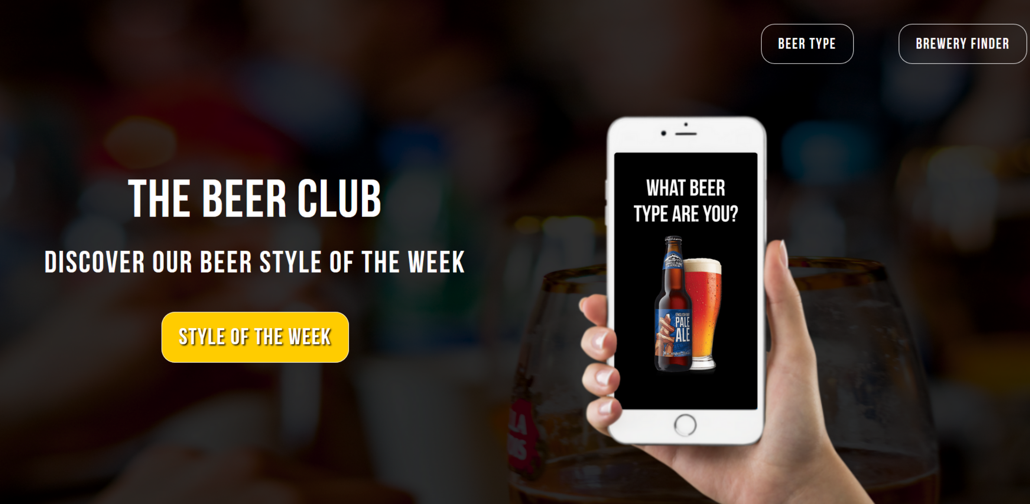
Our homepage

Slide 4
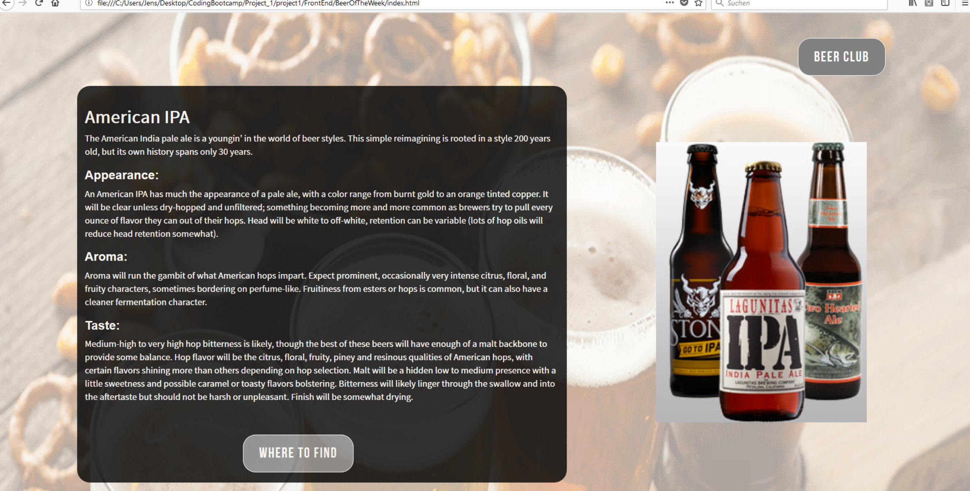
Beer style of the week
Each week, a new beer style will be posted for beer fans…

Slide 5
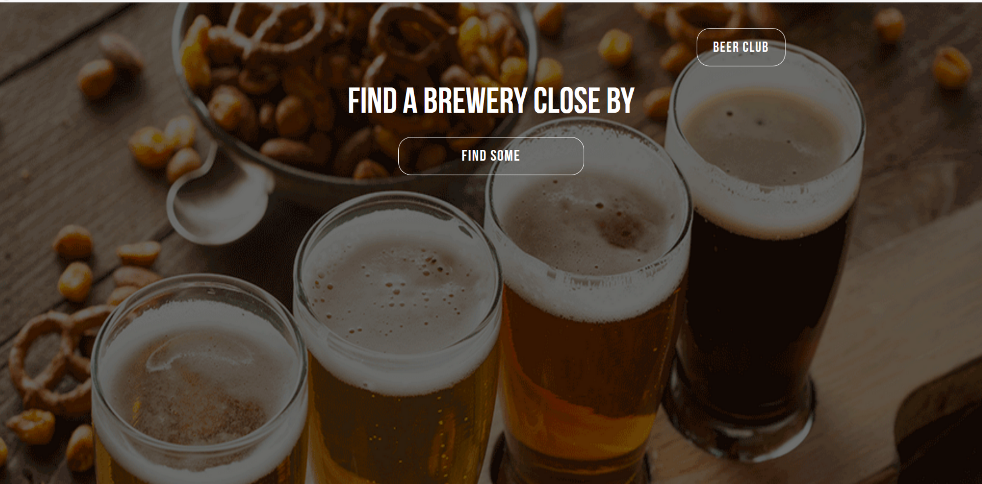
Brewery finder
Find breweries of the featured beer style near you…

Slide 6
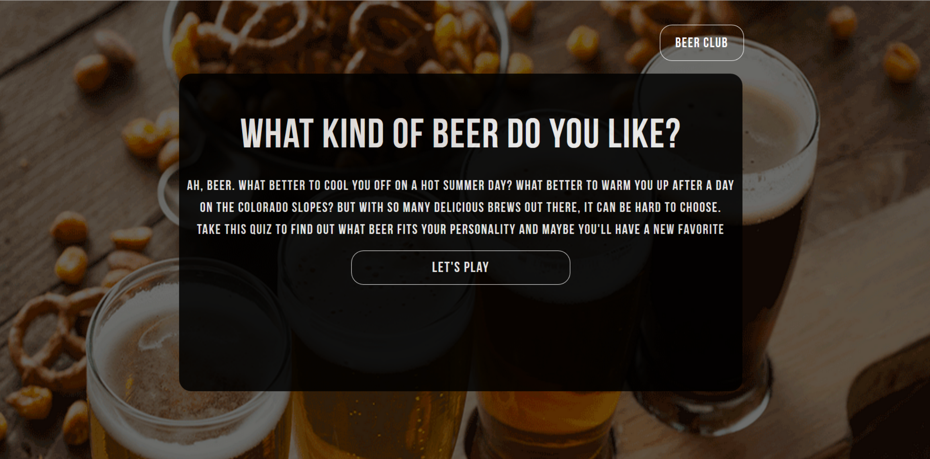
Beer game
We find out what beer fans like…

